Slide 1
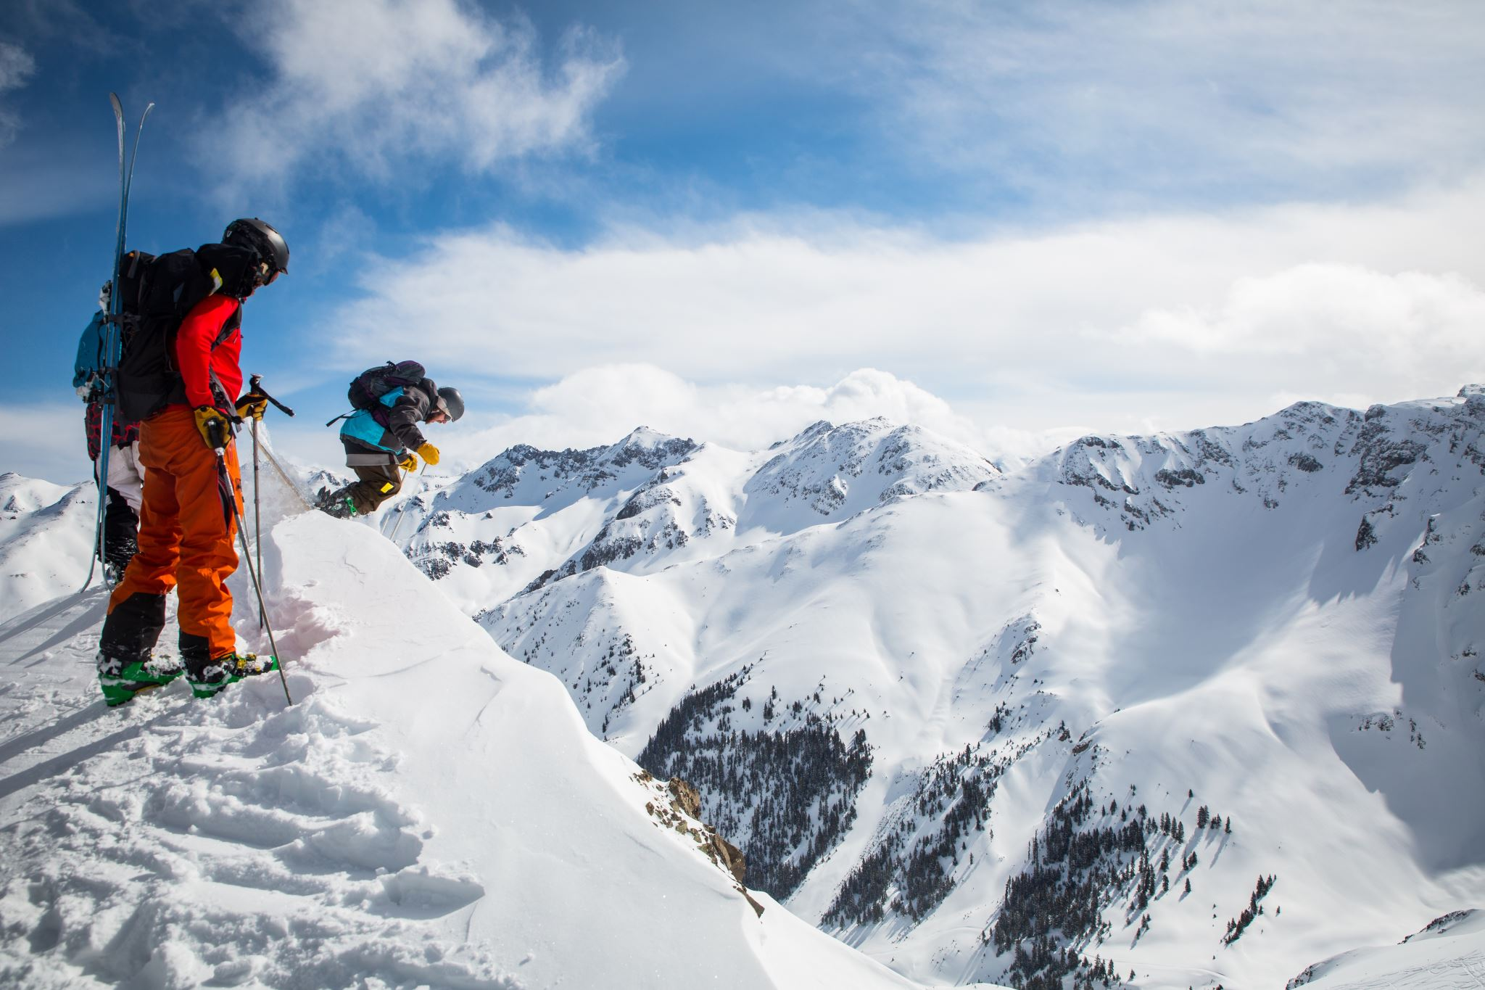
Problem Identification
We, Big Mountain Resorts, want to determine if our current price point is accurate, or if we should lower or heighten it.
We have access to a large amount of data from a multitude of resorts across the US, including amenities and ticket prices
Using the supplied data we will determine a proper pricing model for Big Mountain Resorts that makes sense

Slide 2
Recommendations and Key Findings
From our data we found that Big Mountain Resorts is undervaluing their tickets sold by a large margin at 81$.
Our data showed a minimum price point of 85$ to a maximum of 105$ would make more sense given the current amenities a we host at our resort, but the models key finding was that 95$ was the most appropriate price point.
We also found that Fast Quads, Runs, and Vertical Drop had the largest impact on pricing in that order

Slide 3
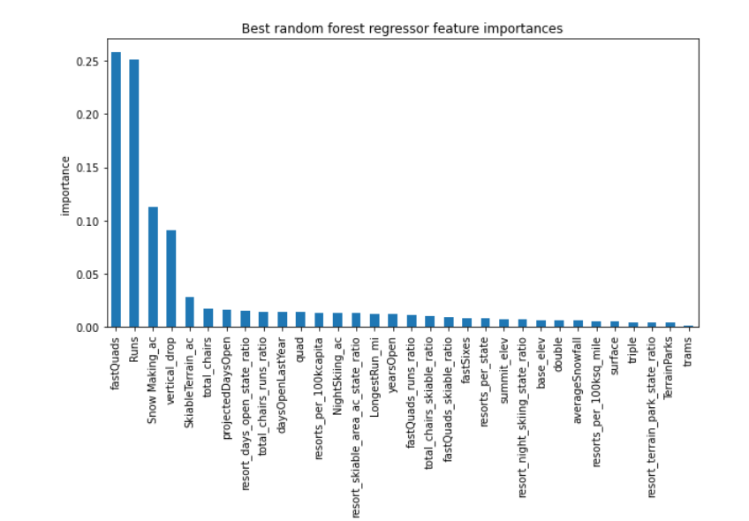
Modeling Results
The figure on the right shows the amenities that people are more willing to pay a premium for.

Slide 4
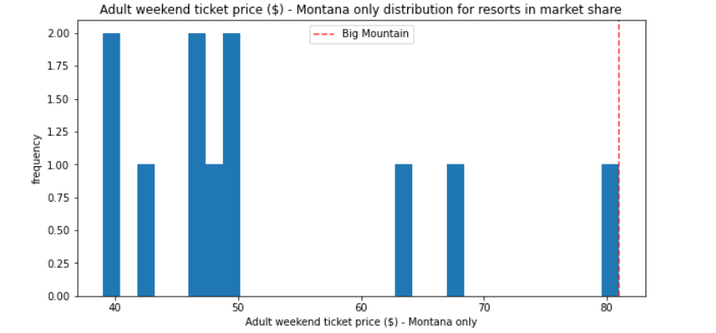
Modeling Results
As shown in the figure, we are the highest priced Resort in Montana this is due to the premium experience our resort supplies, therefore a price increase wouldn’t scare away our customers to any nearby resorts. Our customer base is more than ready to pay a premium.

Slide 5
Conclusion
These analysis are just the tip of the iceberg, using the data provided we can determine the effect adding or removing certain components would have on ticket price
If we were able to get our hands on Ski Resort revenue data, we could justifiably model arguments for cutting or adding certain amenities to the resort
This would allow for us to maximize the total profits of our resorts by cutting costs, and adding assets that would contribute to ticket sales.

